Slide 1
Accelerating Data
Christopher Kingsley
April 14, 2025
Undergraduate Researcher
Advisor: Dr. Doss

Slide 2
Presentation Overview
Overview
Introduction to Bioinformatics
Project Objectives
Research Methodology
Results and Analysis
Optimization
Calculations & Results
Conclusion and Future Work

Slide 3
Basics of Bioinformatics
Background Information
Definition: Analysis of biological data using computational tools.
Key Tasks: Sequence alignment, gene identification, variant analysis.
Challenges: High data volumes and processing time demands.

Slide 4
FPGA and Digital Logic Basics
Background Information
FPGA (Field-Programmable Gate Array): Reconfigurable hardware for specific tasks.
Digital Logic: Hardware-based operations for faster, efficient processing.
Advantage: Parallel processing for higher speed over traditional CPUs.

Slide 5
Why FPGA and VHDL?
Background Information
Parallel Processing
Custom Hardware Design (VHDL - Very High Speed Integrated Circuit Hardware Description Language)
Direct Data Handling

Slide 6
FPGA vs Nvidia Processors
Background Information
Customizability vs. Generalization: FPGAs provide hardware-level customization, while Nvidia GPUs are optimized for general-purpose parallel computing.
Power Efficiency: FPGAs often consume less power for specific tasks, making them more efficient in targeted applications.
Performance Trade-off: GPUs excel in floating-point heavy tasks, whereas FPGAs perform better in data-centric, pipeline-heavy workflows.

Slide 7
Current Limitations
Background Information
Scalability Issues: Growing data volumes are pushing current software to its limits.
Computational Bottlenecks: Processing delays slow down overall analysis.
Need for Speed: Faster processing leads to quicker insights and discoveries.
Development Complexity: Building low-level computations takes time and precision.

Slide 8
Enhancing Bioinformatics Workflow Efficiency
Research Objective
Goal: Improve efficiency in large-scale data processing.
Focus: Streamline analysis, reduce computation time, enhance tool integration.
Objective: Address bottlenecks in bioinformatics workflows.
Impact: Enable faster processing, higher accuracy, and better resource use.

Slide 9
Language Diversity & Fragmentation
Challenges in Bioinformatics Tools
Examples of Bioinformatics Tools and Their Languages:
Cutadapt – Written in Python (adapter trimming)
FastQC – Written in Java (quality control for sequencing)
VirusFinder 2.0 – Written in C++ (virus detection)
HISAT2 – Written in C++ (RNA-Seq read alignment)
StringTie – Written in C++ (transcript assembly and quantification)
Bowtie2 – Written in C++ (read alignment)

Slide 10
Language Diversity & Fragmentation
Challenges in Bioinformatics Tools
Tool-Specific Choices: Languages are selected for specific needs like performance, ease of use, and portability.
Integration Challenges: Different languages require specialized interfaces, complicating workflows.
Maintenance and Performance Issues: Language-specific updates and optimizations can lead to inefficiencies and disrupt long-term maintenance.

Slide 11
Hardware Specifications
Materials
Processor: Intel(R) Core(TM) i5-9600K CPU @ 3.70GHz, 6 Cores, 3.70 GHz
RAM: 16.0 GB Installed RAM
Operating System: Windows 11 Home, 64-bit, x64-based processor
System Architecture: 64-bit architecture

Slide 12
FPGA Hardware Specifications
Materials
Primary Board (Used in Testing): • Board Name: DE2i-150 Development and Education Board • Clock Speed: 50 MHz • FPGA Chip: Altera Cyclone IV E • Use Case: All functional simulations and physical hardware tests were run on this board
Hypothetical Board (Used for Theoretical Analysis): • Board Name: Xilinx Kintex UltraScale+ KU19P • Clock Speed (Max Capable): 500 MHz+ • Purpose: Used to explore projected performance gains if the same VHDL design were ported to a faster, modern board • Note: No physical testing performed — used solely for scaling comparisons

Slide 13
Tools & Software Used
Materials
FastQC: For assessing the quality of sequencing data
Trim Galore: For quality trimming and adapter removal
HISAT2: For aligning sequencing reads to a reference genome
StringTie: For transcript assembly and quantification
Quartus Prime: Used for designing, simulating, and synthesizing VHDL code for FPGA implementation

Slide 14
Workflow Analysis
Research Methodology
Evaluate Bioinformatics Workflow:
Examine overall tool interactions (FastQC → Trim Galore → HISAT2 → StringTie).
Measure processing time and data size for each tool.
Individual Tool Performance:
Track time and size metrics for each tool using different datasets (e.g., SRR7757113, SRR7757114, SRR7767113).
Identify bottlenecks: Tools that take the longest and produce the largest data.

Slide 15
Identifying & Analyzing Bottlenecks
Research Methodology
Focus on Bottleneck Tools:
Time and Size Analysis: Identify the tools causing delays or large data sizes.
Tool Breakdown:
Algorithm Investigation: Examine the algorithm behind the bottleneck tools.
Optimization Opportunities: Identify parts of the algorithm that can be optimized.

Slide 16
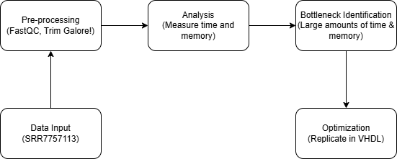
Research Methodology

Slide 17
Sample Time Results
Preliminary Results
Time Results | Upload | Uncompression | FastQC | TrimGalore!
SRR7757113 | 38 minutes | 10 minutes | 11 minutes | 25 minutes
SRR7757114 | 42 minutes | 10 minutes | 9 minutes | 25 minutes
SRR7767113 | 1 minute | 11 seconds | 53 seconds | 2 minutes

Slide 18
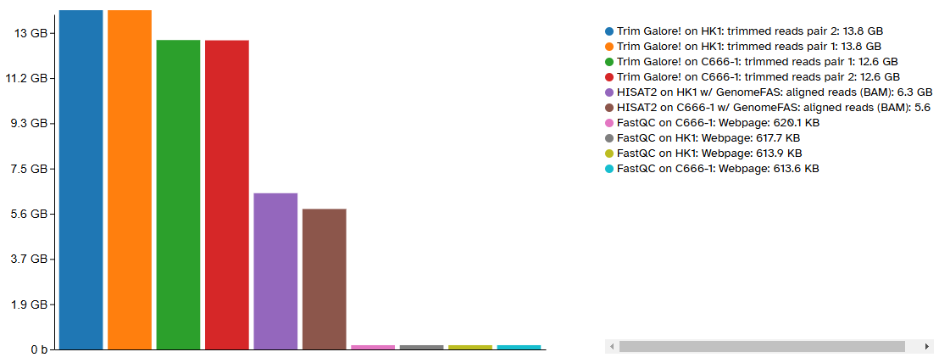
Sample Memory Results
Preliminary Results

Slide 19
Preliminary Results Summary
Preliminary Results
Storage Utilization
Significant storage usage observed with Trim Galore (Python-based tool using Cutadapt and FastQC).
Larger datasets like SRR7757113 require more storage compared to smaller datasets like SRR7767113.
Processing Time
Trim Galore took the longest time for dataset processing (24 mins for SRR7757113).
FastQC processing was consistent across datasets, but Trim Galore’s added complexity and steps led to higher time consumption.
Potential Bottlenecks
Identified Trim Galore as a potential bottleneck in the workflow, mainly due to its combination of multiple tools.
Moving forward, optimization of this tool (starting with FastQC) could significantly reduce processing time.

Slide 20
Approaching Solutions
Optimization
Inefficient Loops: Functions like getMean() and getPercentile() repeatedly iterate over data within nested loops.
Processing Bottlenecks: Redundant iterations slow down performance, especially with larger datasets.
Optimized Approach: Parallelizing functions to run side-by-side, reducing iterations and cutting down processing time.

Slide 21
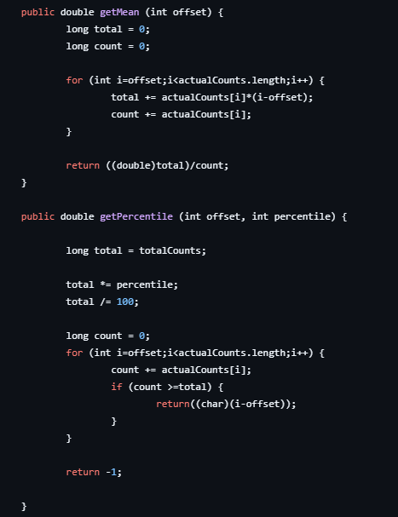
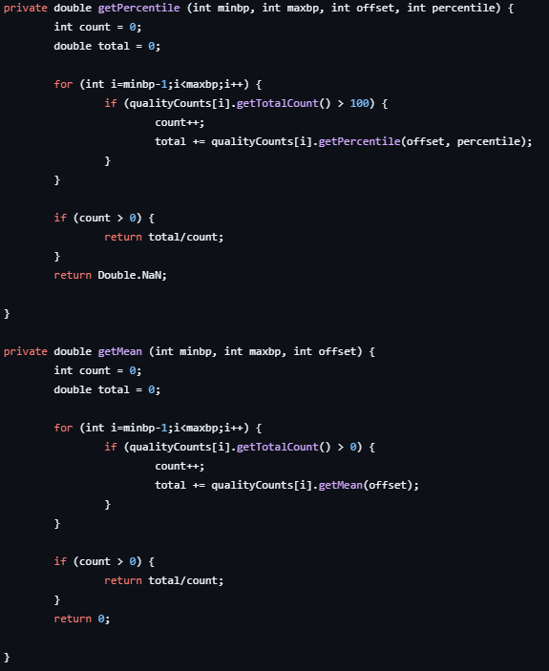
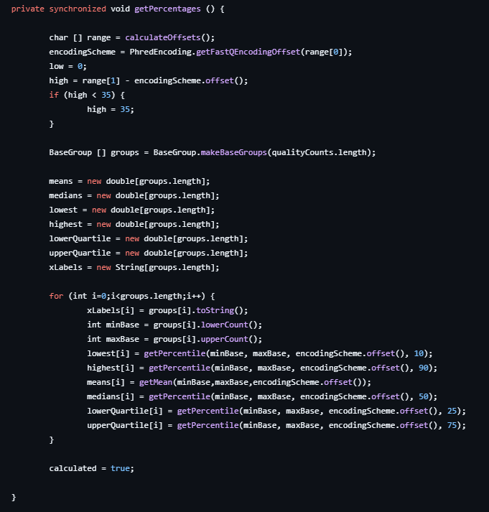
Optimization

Slide 22
VHDL implementation
Optimization
Current Focus: Developing and testing getPercentile() in VHDL for optimized performance.
Progress: getMean() has been implemented in VHDL and is currently under testing.
Next Steps: Finalize getPercentile() development, focusing on parallelism and reducing redundant operations.

Slide 23
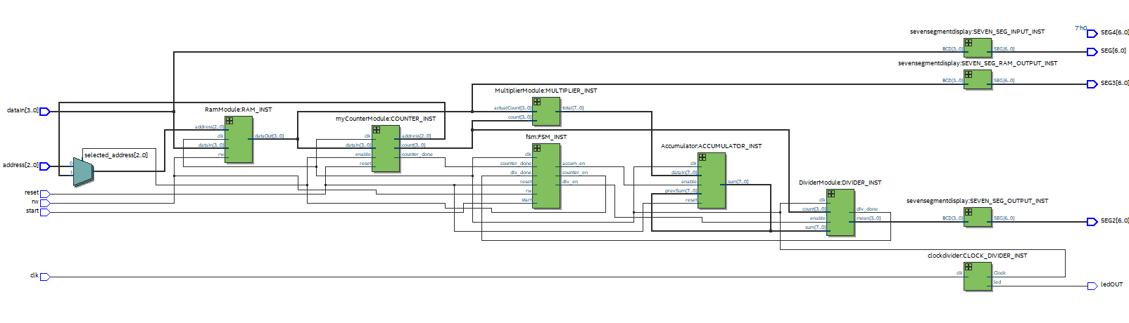
getMean() Schematic Demonstration
Optimization

Slide 24
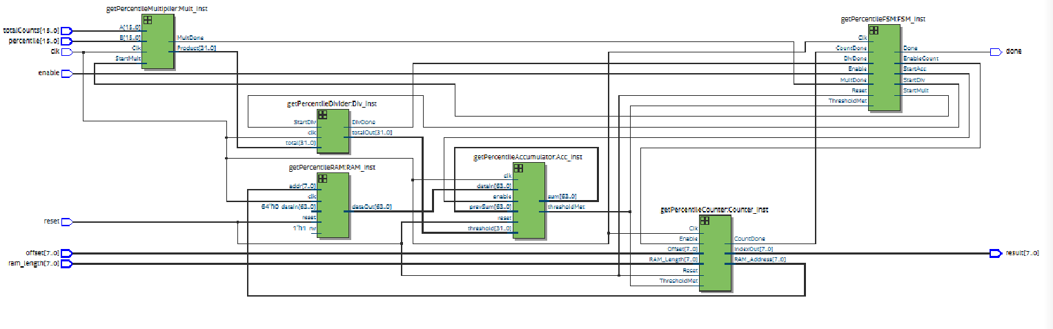
getPercentile() Schematic Demonstration
Optimization

Slide 25
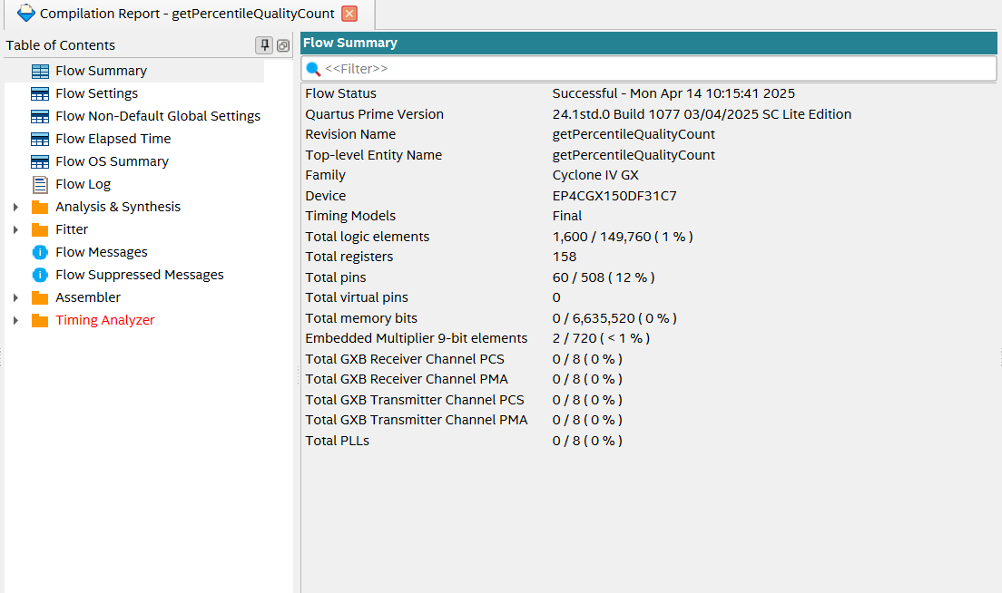
Optimization

Slide 26
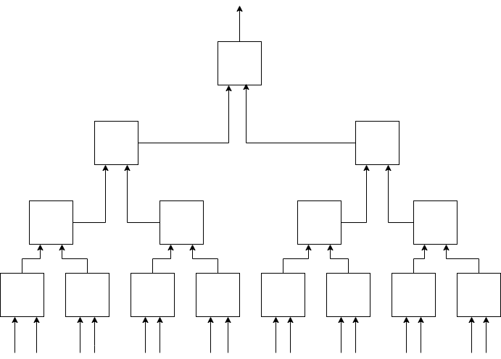
Optimized Accumulation
Optimization

Slide 27
Optimized Accumulation
Optimization
Values are grouped into blocks (e.g., 5 values per block) to compute local prefix sums.
Each block’s total sum is stored and used to build cumulative block sums.
The first block where the cumulative sum ≥ threshold is identified.
That block is then rescanned locally to find the exact crossing index.
Entire architecture is fully combinational or pipelined, offering fixed latency.

Slide 28
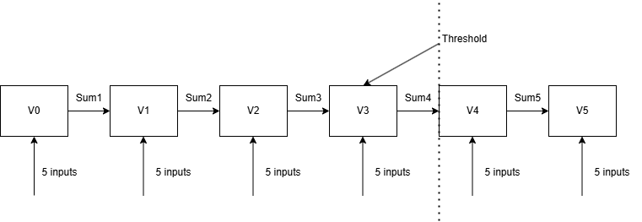
Optimized Accumulation
Optimization

Slide 29
Optimized Accumulation Explained
Optimization
"Imagine each value is a bag of apples..."
You group them into baskets (blocks)
Add apples within each basket
Then stack baskets until you hit a weight limit (threshold)
Only open the last basket to check which bag tipped the scale

Slide 30
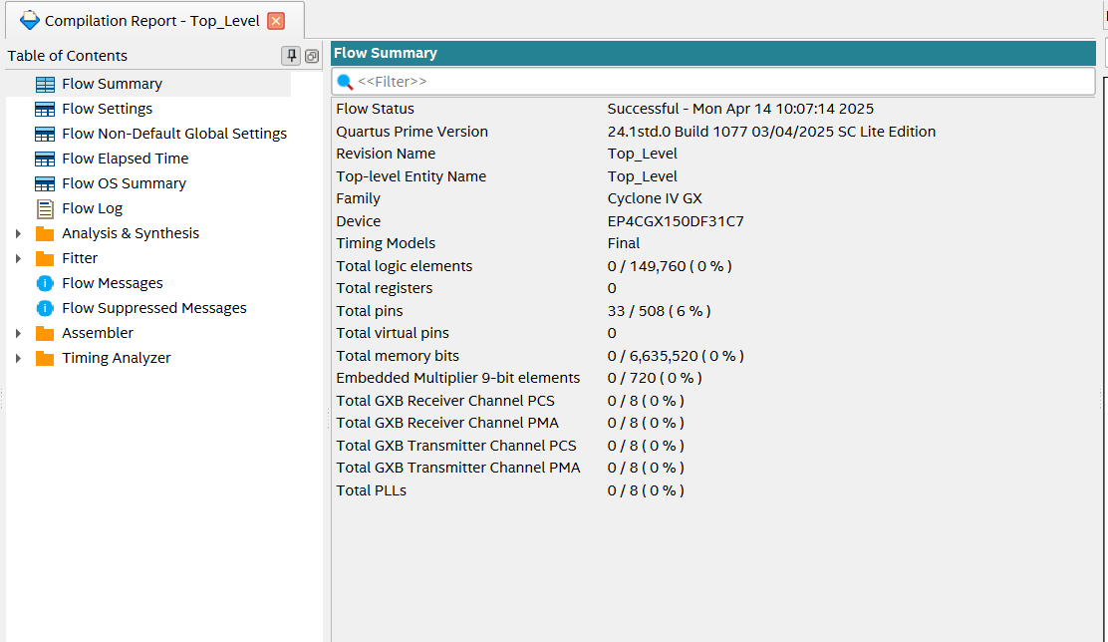
Optimization

Slide 31
Clock Speed and Cycle Analysis: Java vs. FPGA
Calculations
Clock speed tells us how fast a system runs. Aka: high frequency = shorter cycle time.
Time = Cycles x ( 1 / Clock Frequency)
In our tests, Java ran on a 3.7 GHz CPU, and hardware was modeled using a 50 MHz FPGA.
We also did theoretical calculations of how a faster FPGA would perform such as a 1 GHz processor.

Slide 32
Java Performance
Calculations
In the average case, the threshold is reached around iteration 75
There are two ways to retrieve values from memory
Get values from memory
4 cycles (cached)
100 cycles (non-cached)
Add to total - 1 cycle
Compare to threshold - 1 cycle
Increment and check the loop - 2 cycles

Slide 33
Java Performance Table
Calculations
Scenario | Threshold | Memory Access | Total Cycles | Time
Best Case | 1st Value | Cached | 39 | 10.5 ns
Average Case | 75th Value | Cached | 631 | 170 ns
Average Case | 75th Value | Not Cached | 7,831 | 2.11 µs
Worst Case | 150th Value | Not Cached | 15,631 | 4.22 µs
Measured Runtime | 75th Value | Unknown |  | 2.3 µs

Slide 34
VHDL Performance
Calculations
Two Methods: Traditional Iteration vs. Optimized Accumulation
Traditional design reads on value per cycle and checks threshold sequentially
Optimized Accumulation uses a tree-based structure for parallel block summation
Latency reduced from up to 450 cycles (150 values * 3 cycles) to a fixed 15 cycles

Slide 35
VHDL Performance Table
Calculations
Scenario | Cycle Count | Time @ 50 MHz | Time @ 500 MHz
Best Case (Optimized) | 15 cycles | 300 ns | 30 ns
Average Case (Optimized) | 15 cycles | 300 ns | 30 ns
Worst Case (Traditional) | 606 Cycles | 12.12 µs | 1.212 µs

Slide 36
Limitations
Discussion
Current optimization is focused on FastQC and Cutadapt — other bioinformatics tools haven’t yet been analyzed for performance bottlenecks.
VHDL optimizations are hardware-dependent, and full performance benefits require access to high-speed FPGAs, which were not available during development.
The project is constrained by development time — creating, testing, and validating VHDL designs is a time-intensive process.

Slide 37
Conclusion
Conclusion
VHDL acceleration provided significant speed improvements over traditional software.
The getPercentile() design proved reliable and consistent, even on slower hardware.
Java performance varied, while hardware execution stayed predictable and stable.
These results show the value of hardware-aware design in bioinformatics.

Slide 38
Moving Forward
Next Steps
Finalize VHDL Designs: Complete and test getPercentile() and getMean() using the new accumulator logic.
Real Hardware Testing: Analyze combined performance on the FPGA; results expected within the next week.
Scalability & Optimization: Explore further parallelization and refine designs for larger datasets and future tools.

